Slide 1
Unit I
Android and Its Tools (4 Hrs ---4 marks)

Slide 2
Sites to visit:
https://www.tutorialspoint.com/android
https://www.tutlane.com/tutorial/android

Slide 3
 | Android | Windows Phone
Company/ Developer | Google | Microsoft
Programmed in | Java, C, C++ | C, C++
OS family | Unix-like | Windows
Initial release | September 23, 2008 | October 21, 2010
Applications | Applications are created by an open community of developers. | Applications are created by tie up companies and Microsoft.
Number of applications | Over 700,000 applications | Limited number of applications.
Working state | Current | Current
Source model | Open source software | Closed-source
Updates | Updates are provided by different parties | Updates are only done by Microsoft.

Slide 4
Android platform
Android is an open source and Linux-based operating system. It was first introduced on Nov 5, 2007. It was originally developed by Android Inc. and subsequently purchased by Google.
it is not limited to mobile only. It is currently used in various devices such as mobiles, tablets, televisions etc.
allows us to build innovative apps and games for mobile devices in a Java language environment.

Slide 5
Android Features….
Messaging :SMS and MMS are available forms of messaging , Android Cloud To Device Messaging (C2DM) and now, Android Google Cloud Messaging (GCM: allows you to send push notifications from your server to your users' Android devices)
Auto Correction and Dictionary:Android recommends the meaningful and correct words matching the words that are available in Dictionary
Voice-based features
Multi-touch : Android has native support for multi-touch
Multitasking: using this user can jump from one task to another and at the same time various application can run simultaneously
Screen capture :This features supports after Android 4.0
Media Support : Android supports various type of audio/video/still media formats like: H.263, H.264, MPEG-4 SP, AMR, AMR-WB, AAC, HE-AAC, AAC 5.1, MP3, MIDI, Ogg Vorbis, WAV, JPEG, PNG, GIF, BMP and WebP
Multiple language support
Storage : SQLite, a lightweight relational database, is used for data storage purposes

Slide 6
Android Features….
Web Browser : The web browser available in Android
Resizable widgets :
Wi Fi : A technology that lets apps discover and pair directly, over a high-bandwidth peer-to-peer connection
Connectivity : Android supports multiple connectivity technologies including GSM/EDGE, IDEN, CDMA, EV-DO, UMTS

Slide 7
Why Android platform for mobile application development…..
Zero/negligible development cost : The development tools like Android SDK, JDK, and Eclipse IDE etc. are free to download for the android mobile application development
. Also Google charge a small fee $25, to distribute your mobile app on the Android Market.
Open Source
The Android OS is an open-source platform based on the Linux kernel and multiple open-source libraries. In this way developers are free for building mobile apps

Slide 8
Why Android platform for mobile application development…..
Multi-Platform Support : wide range of hardware devices powered by the Android OS.
Even development of android mobile apps can occur on Windows, Mac OS or Linux.
Open Distribution Model
Android Market place (Google Play store) has very few restrictions on the content or functionality of an android app.
So the developer can distribute theirs app through Google Play store and as well other distribution channels like Amazon’s app store.

Slide 9
Types of mobile application
Native : - Device oriented , app interact only with device through OS
- speedy eg: android based Calc , Calendar
Web: not a device oriented , app interact through web browser .example : access of Uber through web browser.
Hybrid : combination of both. Hybrid mobile apps require users to go to the app store, download the app and periodically get updated from the store.
eg : Gmail , Instagram , twitter

Slide 10
What is Android
Android is an open source and Linux-based Operating System for mobile devices such as smartphones and tablet computers.
Android was developed by the Open Handset Alliance
OHA : (The Open Handset Alliance ) is a business alliance that was created for the purpose of developing open mobile device standards.
Is a group of more than 80 companies including Dell , Google, HTC
The first beta version of the Android Software Development Kit (SDK) was released by Google in 2007 where as the first commercial version, Android 1.0, was released in September 2008.
On June 27, 2012, at the Google I/O conference, Google announced the next Android version, 4.1 Jelly Bean.

Slide 11
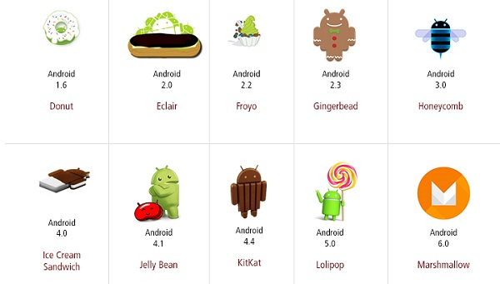
Android versions

Slide 12
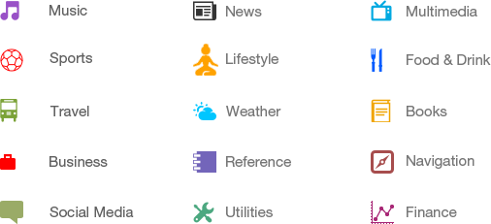
Android Applications
Android applications are usually developed in the Java language using the Android Software Development Kit.
Once developed, Android applications can be packaged easily and sold out either through a store such as Google Play, SlideME, Opera Mobile Store and the Amazon Appstore.
Android App categories:

Slide 13
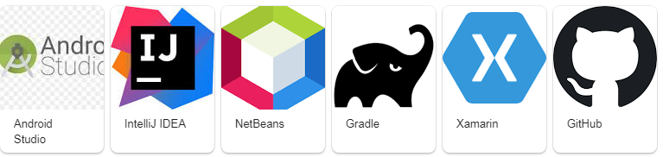
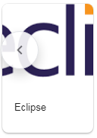
Tools for App development

Slide 14
Tools for Android Development
1. Android Studio :Android Studio is the official IDE for Android development, and includes everything you need to build Android apps.
2. Eclipse
There was Eclipse before there was Android Studio. For a long time, Eclipse was the officially preferred IDE for all Android application development.
Instabug:
Instabug allows beta testers and user groups to share screenshots and detailed error logs with developers during the QA
GameMaker: Studio:
GameMaker provides everything you need to create 2D games using very little code.

Slide 15
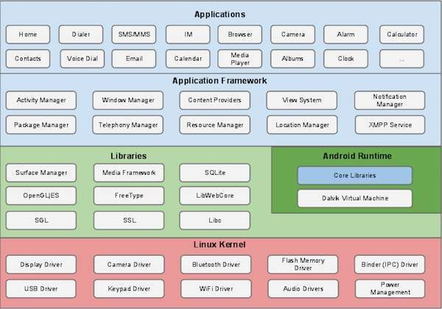
Android Architecture

Slide 16
1. Linux Kernal:
This provides a level of abstraction between the device hardware and it contains all the essential hardware drivers like camera, keypad, display etc.
To run device app , it require CPU , memory and device resource . Kernal manage these things.
2. Libraries :
Is a collection of data which can do any number of things: set rules for app behaviour, graphic effects, pre-written code, templates, text, communication protocols.
Android support many libraries to build an app
Eg : SQLite database which is a useful repository for storage and sharing of application data
Eg:Media Framework to develop musical app
3.Android Run time:
This section provides a key component called Dalvik Virtual Machine which is a kind of Java Virtual Machine specially designed and optimized for Android.

Slide 17
3.Android Run time:
This section provides a key component called Dalvik Virtual Machine which is a kind of Java Virtual Machine specially designed and optimized for Android.
The Dalvik VM makes use of Linux core features like memory management and multi-threading.
DVM (Dalvik Virtual Machine) which provide run time environment to run android app. DVM build .DEX files.
The Android runtime also provides a set of core libraries which enable Android application developers to write Android applications using standard Java programming language.
.Class Files
DX tool
.Dex Files
APK
AAPT tool
Java files
binary files

Slide 18
In Lolipop version google introduce ART(Android runtime environment).
DVM is replaced by ART.
ART – performance is fast
- - Improved garbage collection
- introduce AOT (ahead of time )concept : compile the entire app at a time
AAPT (Android Asset Packaging tool)
AAPT tool allow to view , create and update inside app
AAPT compile the resource (XML code ) to binary format to store in to device

Slide 19
4. Application Framework
It manage basic function of our app
Eg : Telephony Manager to provide call functionality to manages all voice calls
Application developers are allowed to make use of these services in their applications.
Activity Manager − Controls all aspects of the application lifecycle and activity stack.
Content Providers − Allows applications to publish and share data with other applications.
Resource Manager − Provides access to non-code embedded resources such as strings, color settings and user interface layouts.
Notifications Manager − Allows applications to display alerts and notifications to the user.
View System − An extensible set of views used to create application user interfaces.
5. Application : eg : Alarm , Calendar , Contact etc

Slide 20
Android - Application Components
Your app must declare all its components in AndroidManifest file, which must be at the root of the app project directory.
These components are loosely coupled by the application . Manifest file AndroidManifest.xml that describes each component of the application and how they interact.
There are following four main components that can be used within an Android application −
1.Activity : Activity performs actions on the screen.
-For example, an email application might have one activity that shows a list of new emails, another activity to compose an email.
If an application has more than one activity, then one of them should be marked as the activity that is presented when the application is launched.
An activity is implemented as a subclass of Activity class as follows −
Eg : Public class MainActivity extends Activity {
2. Service : is a component that runs in the background to perform long-running operations.
For example, a service might play music in the background while the user is in a different application, or
it might fetch data over the network without blocking user interaction with an activity.
eg : Public class MyService extends Service {

Slide 21
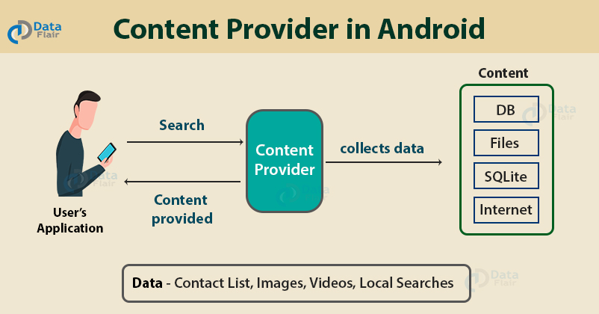
Content Provider

Slide 22
4. Content Providers
A content provider component supplies data from one application to others on request.
Eg : Public class MyContentProvider extends ContentProvider{
eg : The Gallery that contains images , Contact lists that contain Contact details.
3. Broadcast Receivers:
A broadcast receiver is a component that enables the system to deliver events to the app outside of a regular user flow.
Broadcast receiver is an Android component which allows you to send or receive Android system or application events. All the registered application are notified by the Android runtime once event happens.
For example, applications can register for various system events like boot complete or battery low, and Android system sends broadcast when specific event occur. Any application can also create its own custom broadcasts.
Eg : an app can schedule an alarm to post a notification to tell the user about an upcoming event... by delivering that alarm to a BroadcastReceiver of the app.
Public class MyReceiver extends BroadcastReceiver {

Slide 23
API (Application Programming Interface )level
Android API level settings that determine your app's compatibility with multiple versions of Android.
each Android version is assigned a unique integer identifier, called the API Level.
The API level precisely identifies the version of the API set that your app can call into

